Slide 1
Puzzle Oracle Manual Brief Introduction
For puzzle creators, event administrators and event instructors Covers Software Version: 0.0
By Joseph M. Joy
Copyright © 2015, Rinworks, LLC Creative Commons License "Attribution 4.0 International (CC BY 4.0)" (http://creativecommons.org/licenses/by/4.0/)
Notes:
Welcome to a brief introduction to Puzzle Oracle. This presentation is to be viewed as a Microsoft "Mix" because the annotations add an important component. The Puzzle Oracle is an windows executable program. It is designed to be self-contained – everything it needs is on a thumb drive, including the program itself. It does not require administrator preveleges to run and does not access the network or any other location on the PC. Let's take a look at the thumb drive contents….

Slide 2
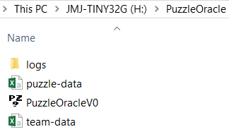

Thumb drive contents
Notes:
Everything is located under the "PuzzleOracle" top-level directory on the thumb drive. The program itself is here. There are two data files also in this directory – these provide information about puzzles and teams. The relevant portions of these files are encrypted so team members gain no benefit by looking into them. There is also a logs sub directory. The Puzzle Oracle logs all questions asked of it into one or more log files in this directory.
The rest of this brief introduction focuses on the Puzzle Oracle user interface. Clicking/starting the Puzzle Oracle program <here> launches the start screen which we see next…

Slide 3

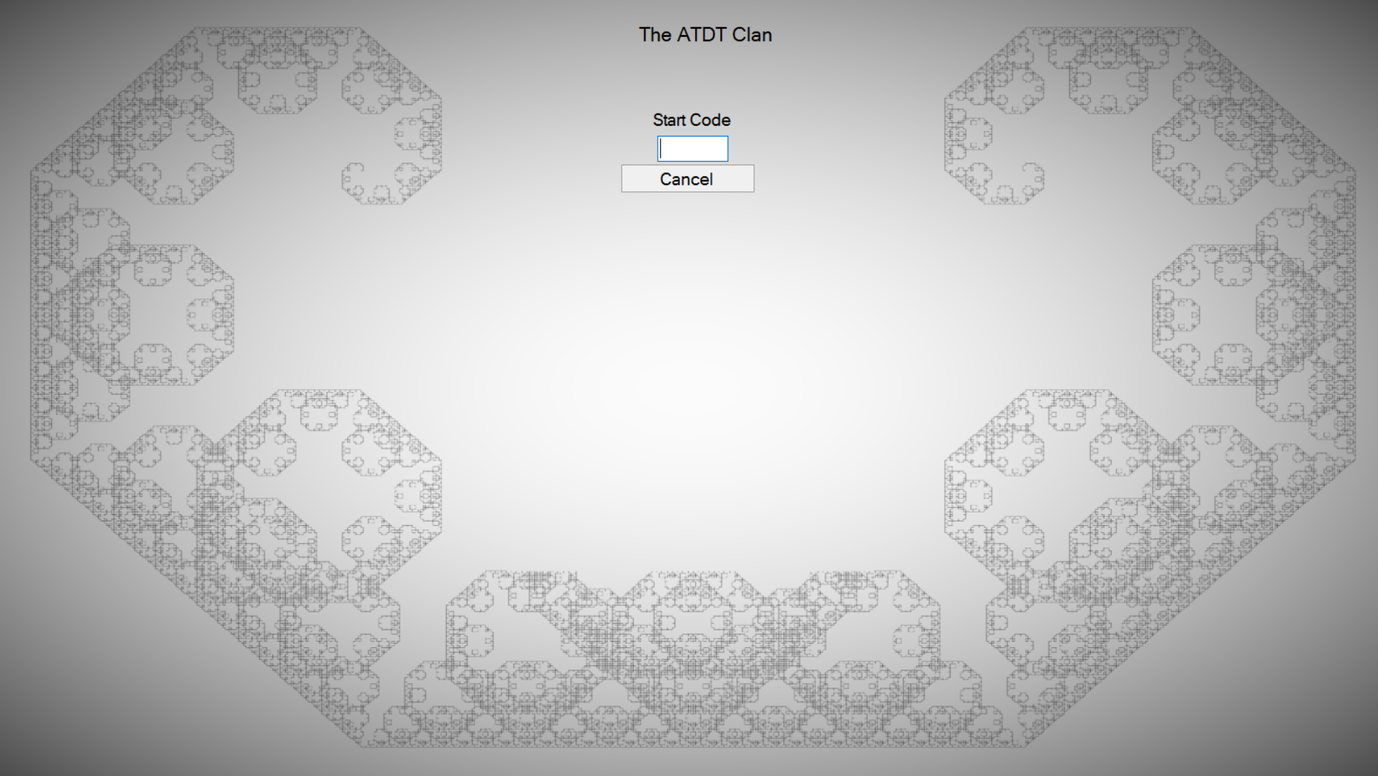
Start screen (F1 toggles full-screen mode)
Notes:
This is the start screen. F1 toggles full-screen mode. In future versions, full-screen may be the only option, to minimize distractions. You'll notice that the team name is listed on the top – each instance of the Puzzle Oracle is intended for a single teamThe Puzzle Oracle uses the machine name and the data files to identify the team. . It is very important that this is correct to facilitate correct processing of oracle log files (these files are use to provide intermediate standings).
To progress beyond the start screen an instructor must enter a valid start code. Thus, this program cannot be started by a player (or if they do, they have to get an instructor to enter the start code.) On entering a valid start code we get to the next screen – the puzzle number entry screen….

Slide 4
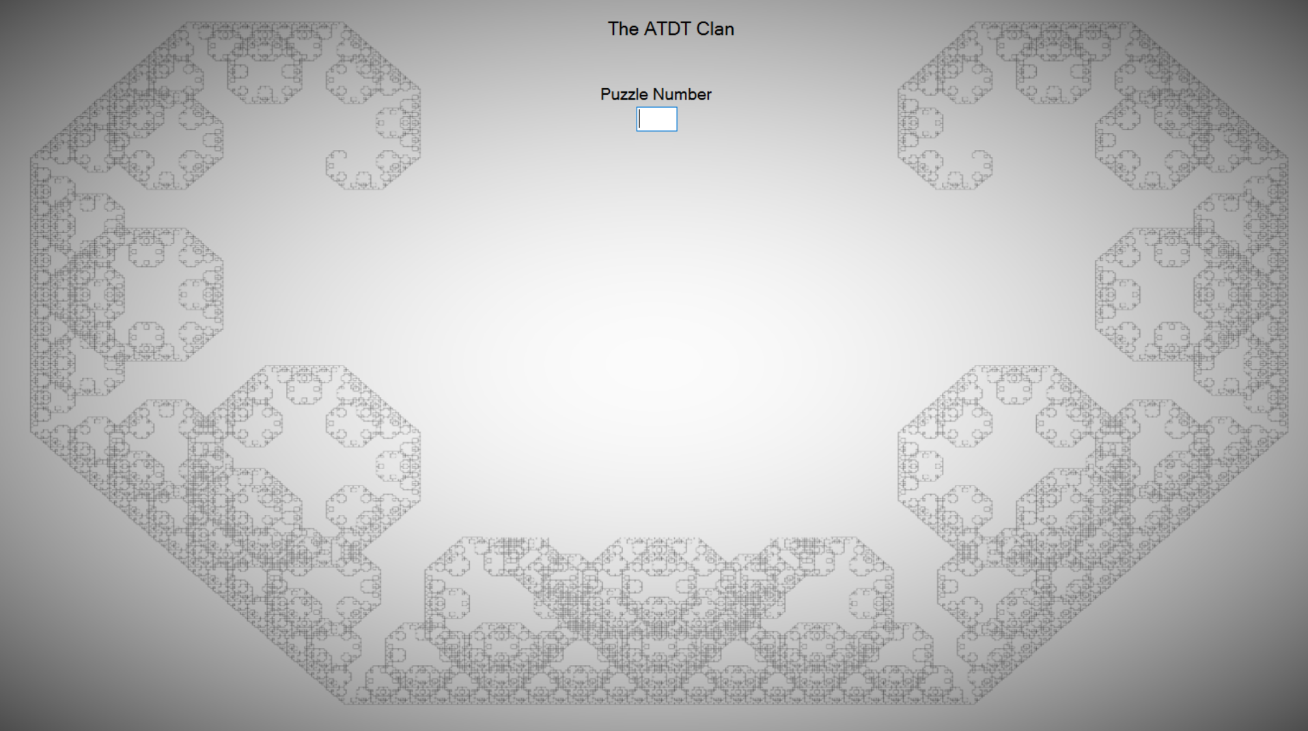

Initial puzzle-entry screen
Notes:
The Puzzle Number entry screen is simple – it is expecting a 3-digit number to be typed in. On entering the 3-digit number of a valid puzzle, the Puzzle Oracle goes on to display the puzzle name, and starts accepting solution attempts, as is shown on the next screen…

Slide 5
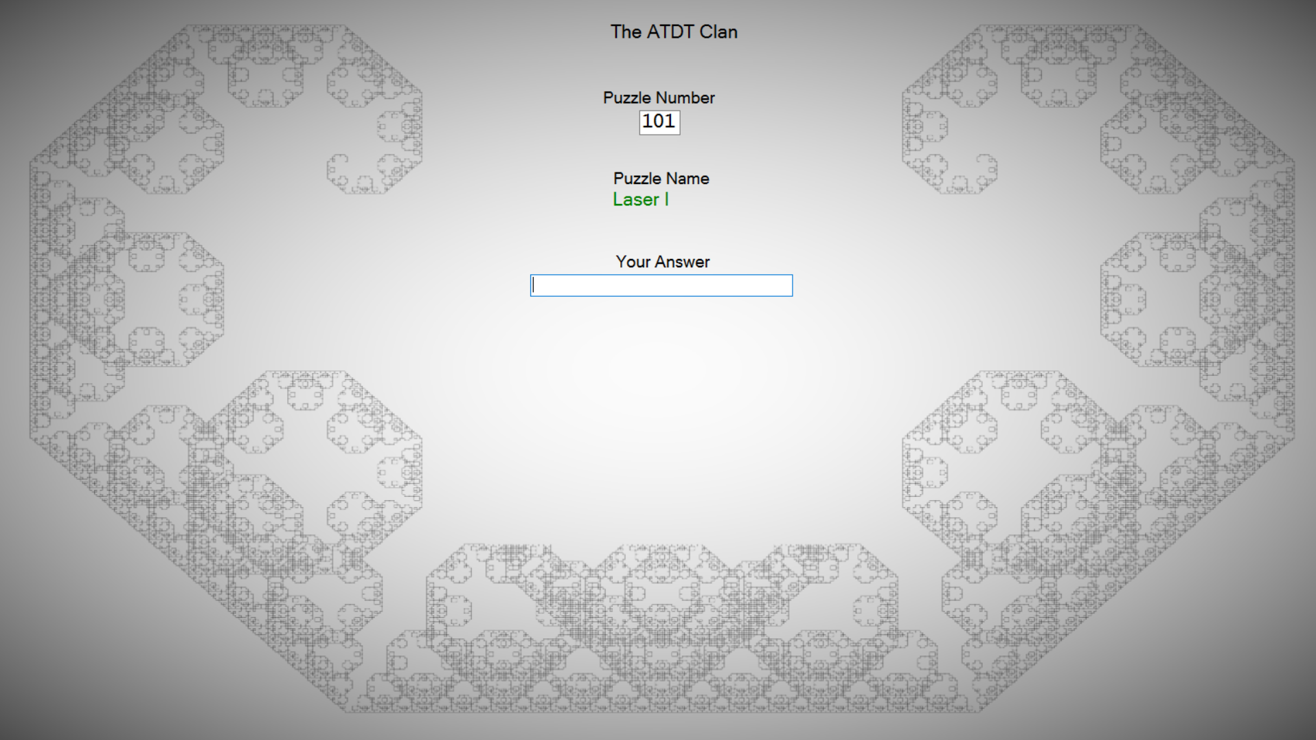

Screen after entering a valid puzzle number
Notes:
Once a valid puzzle number has been entered (previous screen) focus shifts to the edit box labeled "Your Answer". (Note: verify that the displayed puzzle name matches the name of your puzzle.) As soon as the user starts typing into the edit box a button pops up inviting to submit your solution, as seen on the next slide…

Slide 6
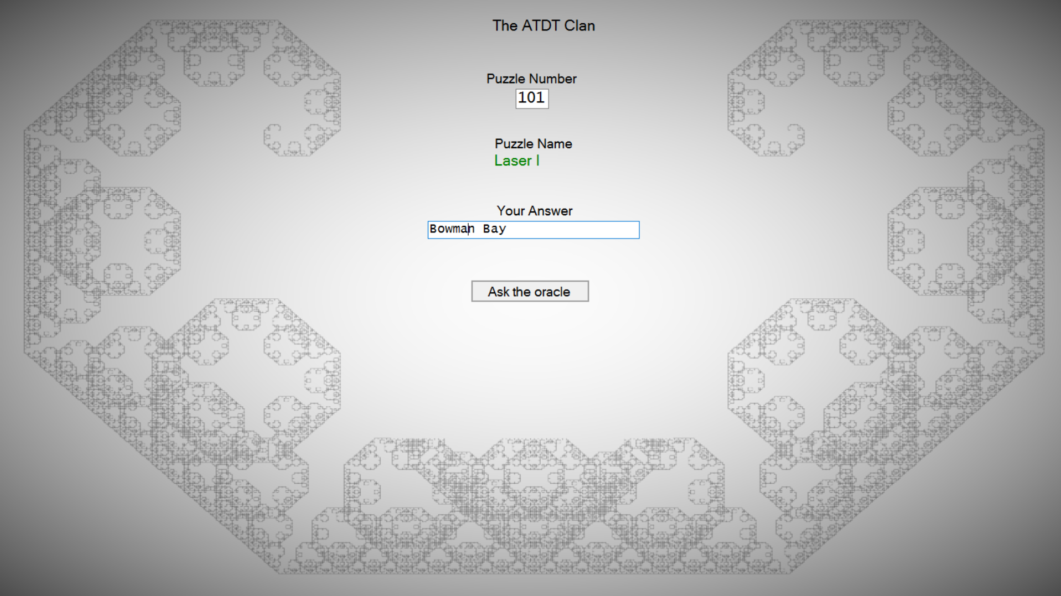

Screen once you start entering your answer
Notes:
Here we see that the user has entered Bowman Bay. Clicking on "Ask the oracle" (or simply pressing the enter key) will submit your solution attempt to the oracle, which will check your response and respond accordingly. "Bowman Bay" happens to be the correct answer to this puzzle, as is clear from the Oracle's response on the next slide…

Slide 7
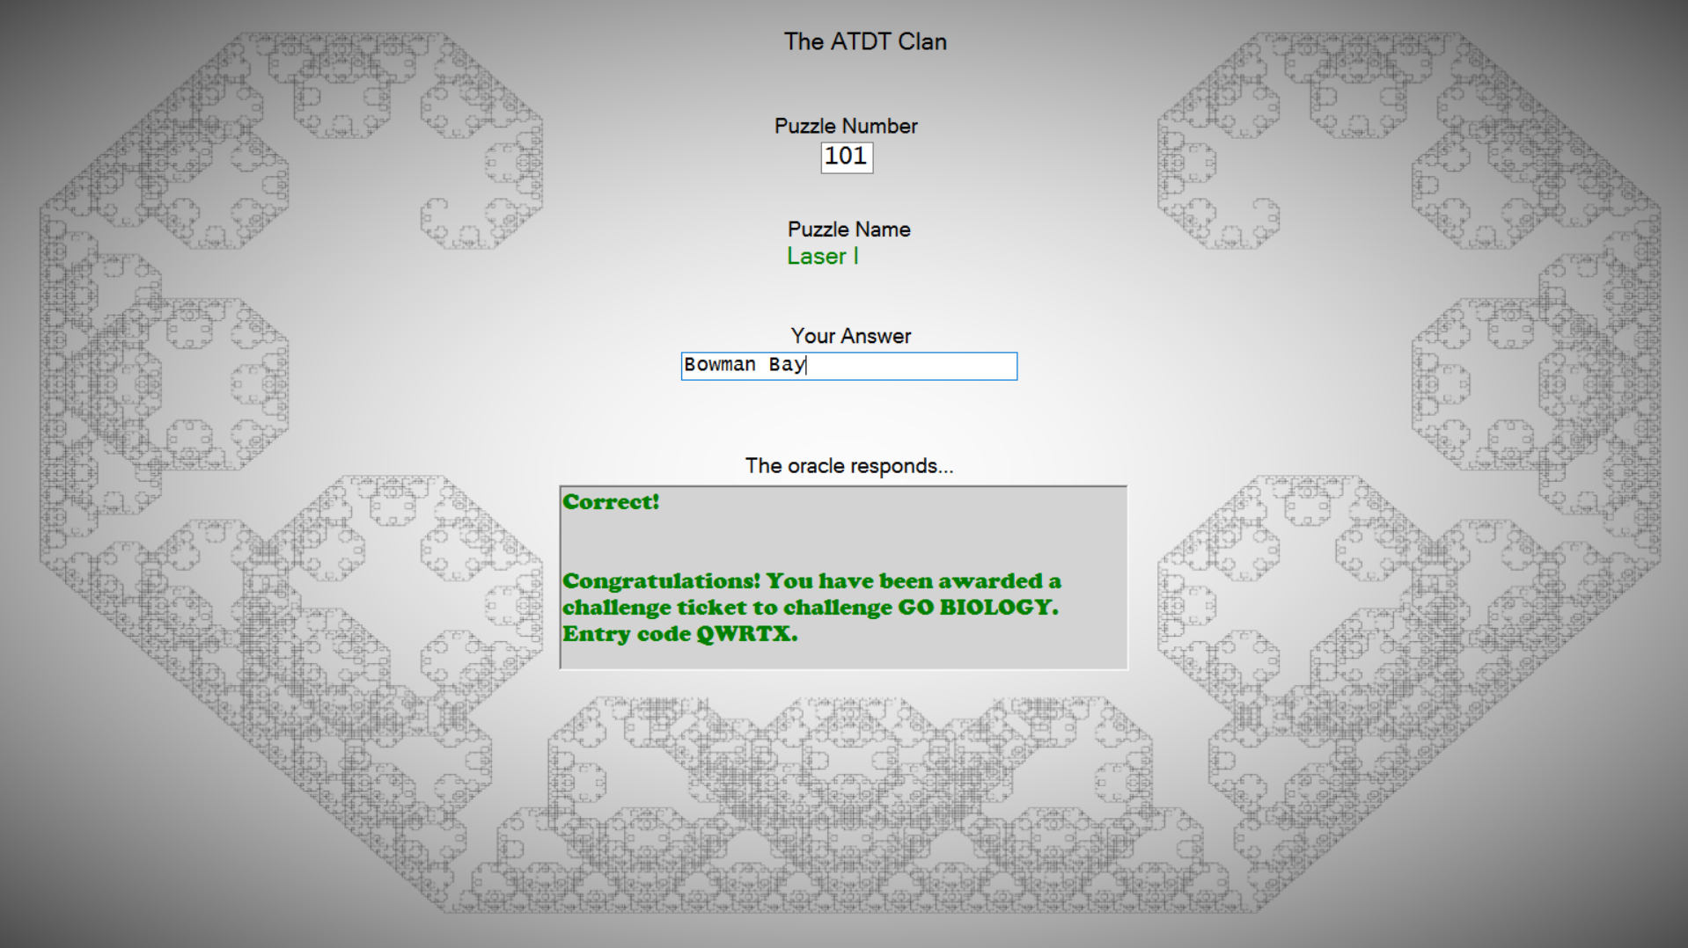

Oracle response to correct answer
Notes:
The Oracle responds "Correct!" and follows that up with important further instructions.
So having successfully verified the solution to one puzzle, puzzle with number 101 called "Laser 1", how do you attempt the answer to another puzzle?
You simply enter another puzzle number into the topmost edit box and the screen resets to the puzzle number entry view. The system will also spontaneously reset to the puzzle number entry view after the system has been idle for some time.
Back to the puzzle entry view…

Slide 8
Back to the puzzle-entry screen
Notes:
You can now check other puzzles.
The Puzzle Oracle is not intended to be closed by team members. Attempting to close the program brings up an "exit screen" which once again requests for an instructor-provided exit code – as we see on the next slide…

Slide 9
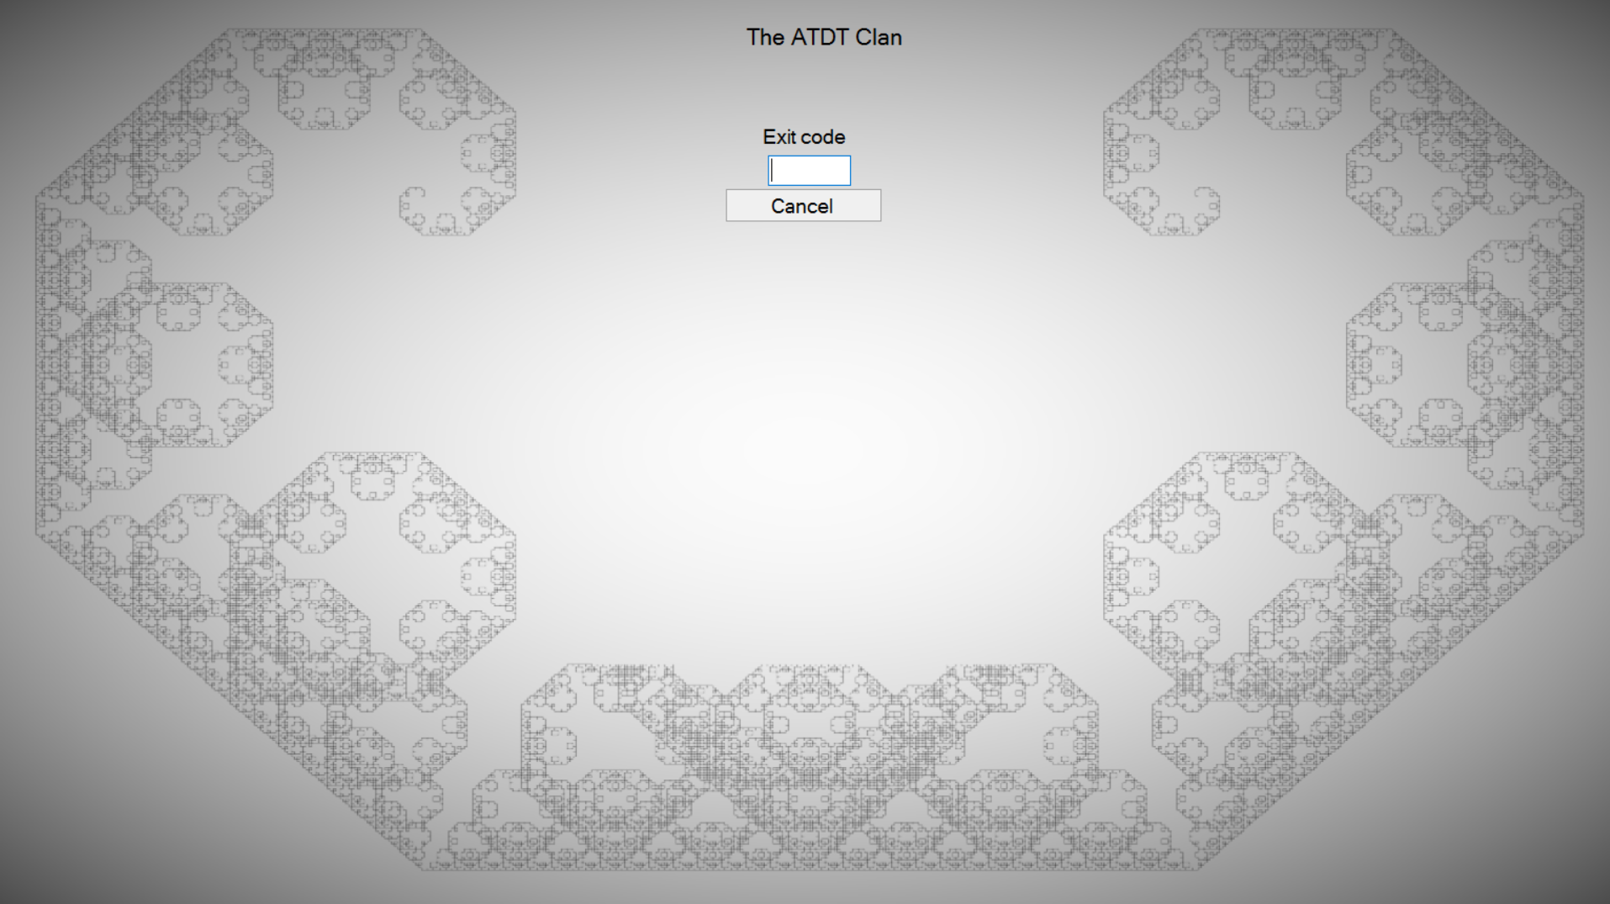
Exit screen
Notes:
This is the exit screen. You get here if you attempt to close the program by "normal methods" which include clicking on the windows close button or typing ALT-F4. If you get to this screen by accident, simply press the ESC key or type a random code to get back to the Puzzle number entry screen. If the user enters a valid exit code the program exits.
Note: if you kill the program using the task manager or some other mechanism that directly kills processes you will not get this screen and the program will simply exit. If you attempt to start the program again it will of course start at the entry screen, which requires the instructor-provided entry code.
This concludes the brief introduction to the puzzle oracle.

